Slide 1
Programming Practices
Prof. Dr. Dirk Riehle
Friedrich-Alexander University Erlangen-Nürnberg
AMOS E02
Licensed under CC BY 4.0 International
Notes:
It is Friedrich-Alexander University Erlangen-Nürnberg – FAU, in short.
Corporate identity wants us to say “Friedrich-Alexander University”.

Slide 2
General Principles 1 / 4
KISS
(Keep It Simple, Silly)

Slide 3
General Principles 2 / 4
YAGNI
(You Ain’t Gonna Need It)

Slide 4
General Principles 3 / 4
DRY
(Don’t Repeat Yourself)

Slide 5
General Principles 4 / 4
Make it run
Make it right
Make it fast

Slide 6
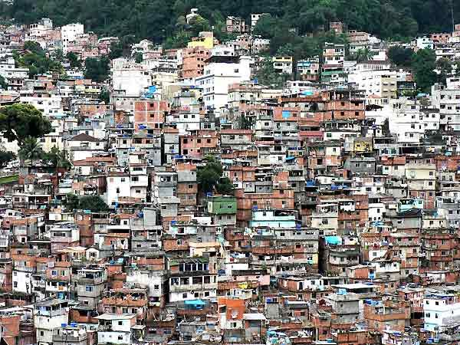

Slide 7
Definition of Big Ball of Mud [FY97]
A Big Ball of Mud is a haphazardly structured, sprawling, sloppy, duct-tape-and-baling-wire, spaghetti-code jungle. These systems show unmistakable signs of unregulated growth, and repeated, expedient repair. Information is shared promiscuously among distant elements of the system, often to the point where nearly all the important information becomes global or duplicated. The overall structure of the system may never have been well defined. If it was, it may have eroded beyond recognition. Programmers with a shred of architectural sensibility shun these quagmires. Only those who are unconcerned about architecture, and, perhaps, are comfortable with the inertia of the day-to-day chore of patching the holes in these failing dikes, are content to work on such systems.

Slide 8
Benefits of Good (“Well-Factored”) Code
Maintainability
(Easier to understand)
Extensibility
(Easier to adapt and evolve)
Predictability
(Improves planning ability)

Slide 9
Video on Technical Debt [1]
Technical Debt
(Ward Cunningham)
[1] See https://youtu.be/Jp5japiHAs4

Slide 10
Video Lessons
Technical Debt is a Metaphor
  Communicates well to manager
  (Certainly in financial services)
Taking on debt can speed up development
  It may be justified to learn faster
  But you have to pay up later
If you don’t pay back debt you’ll slow down
  Paying up means refactoring
  Still, never write poor code deliberately

Slide 11
Handling Technical Debt
Identify problem
(So-called “code smells”)
Identify need to act
(Correlate occurrences)
Know how to act
(Refactor code)

Slide 12
Code Smell
According to Fowler [F99]
  “smells are certain structures in the code that indicate violation of fundamental design principles and negatively impact design quality”
  also, “a code smell is a surface indication that usually corresponds to a deeper problem in the system”
Code smells are not bugs

Slide 13
Example Code Smells
Duplicated Code
Long Method
Large Class
...

Slide 14
Refactoring (Practice)
Definition and purpose
  Is a behavior-preserving transformation of existing source code
  It is a change made to the internal structure of software to make it easier to understand and cheaper to modify without changing its observable behavior
More on refactoring
  Change the structure of code without changing behavior
  Focus on non-functional features within range of specification
  Are defined techniques that are typically language specific
  Are ideally supported by IDEs, for example, the Eclipse JDT
Defined by Opdyke [O92], popularized by Fowler [F99]

Slide 15
Example Refactorings
Rename class
Pull-up field
Extract method
…
More at http://refactoring.com

Slide 16
Example Extract-Method Refactoring 1 / 2
public class PhotoManager extends ObjectManager {
protected Map<PhotoId, Photo> allPhotos = new HashMap<PhotoId, Photo>();
public void addPhoto(Photo photo) {
PhotoId id = photo.getId();
assertIsNewPhoto(id);
allPhotos.put(id, photo);
...
}
public Photo getPhotoFromId(PhotoId id) {
Photo result = doGetPhotoFromId(id);
if (result == null) {
...
if (result != null) { allPhotos.put(id, result); }
}
return result;
}
public Set<Photo> findPhotosByOwner(String ownerName) {
...
for (Iterator<Photo> i = r.iterator(); i.hasNext();) {
Photo photo = i.next();
allPhotos.put(photo.getId(), photo);
}
return r;
}
...

Slide 17
Example Extract-Method Refactoring 2 / 2
public class PhotoManager extends ObjectManager {
public void addPhoto(Photo photo) {
...
doAddPhoto(photo);
...
}
public Photo getPhotoFromId(PhotoId id) {
...
doAddPhoto(photo);
...
}
public Set<Photo> findPhotosByOwner(String ownerName) {
...
for (Iterator<Photo> i=r.iterator(); i.hasNext(); ) {
doAddPhoto(i.next());
}
...
}
protected void doAddPhoto(Photo myPhoto) {
allPhotos.put(myPhoto.getId(), myPhoto);
}
...

Slide 18
When to Refactor?
The “three strikes” rule
1st time: Just do it
2nd time: Wince at duplication
3rd time: Refactor

Slide 19
Refactoring Process (Two Hats)
code smells
Add Function
Refactor
code does not
smell anymore

Slide 20
Code Smells and Refactorings
Duplicated code
Extract method
Long method
Pull up field
Large class
Form template method
...
Decompose conditional
Extract class
Extract subclass
Extract interface
...

Slide 21
Example Refactoring Process
The refactoring process can become complex
  It may turn into a series of refactorings
Example Removal of Switch Statement
  Extract Method
  Move Method
  Replace Type Code …
    with Subclass or
    with State / Strategy
  Replace Conditional ...
    with Polymorphism

Slide 22
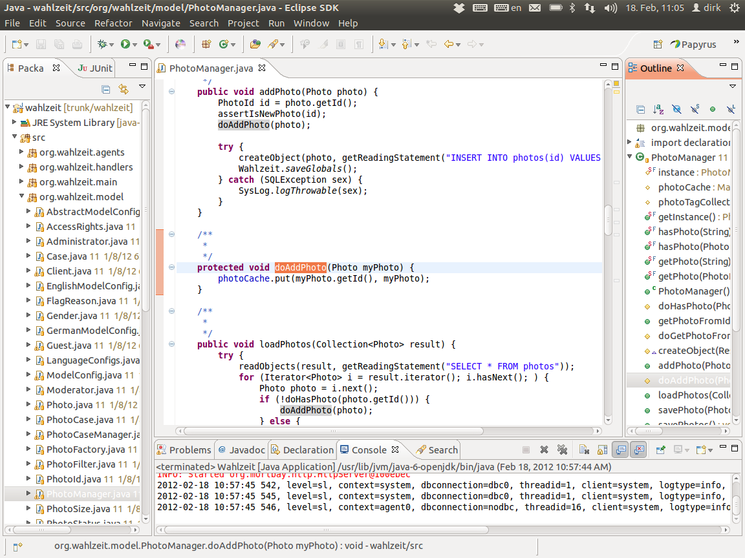

Slide 23
Quiz on Refactoring
Your code smells. All signs for refactoring are given. Under which circumstances should you not start a refactoring?
Notes:
The code will be abandoned (no business value in refactoring)
You are already in the middle of a refactoring---finish that first

Slide 24
Review / Summary of Session
Agile principles of programming
  KISS, YAGNI, DRY
  Make it run, right, fast
Technical debt and refactoring
  Principles, two hats
  Example refactorings and tools

Slide 25
Thank you! Questions?
dirk.riehle@fau.de – http://osr.cs.fau.de
dirk@riehle.org – http://dirkriehle.com – @dirkriehle
DR

Slide 26
Credits and License
Original version
  © 2020 Dirk Riehle, some rights reserved
  Licensed under Creative Commons Attribution 4.0 International License
Contributions
  None yet

